Slide 1
COMP9024: Data Structures and Algorithms
Week Three: Linked Lists and Recursion
Hui Wu
Session 2, 2015
http://www.cse.unsw.edu.au/~cs9024

Slide 2
Outline
Singly Linked Lists
Doubly Linked Lists
Recursions

Slide 3
Data Structures and Algorithms
Data structures
  A data structure is a way of storing data in a computer so that it can be used efficiently.
Algorithms
  An algorithm is a finite sequence of well-defined instructions for solving a problem and guaranteed to terminate in a finite time.
  An algorithm does not necessarily need to be executable in a computer, but can be converted into a program.

Slide 4
Algorithms versus Heuristics
Heuristics
  A heuristic is a finite sequence of well-defined instructions for partially solving a hard problem and guaranteed to terminate in a finite time.
  A heuristic is not always guaranteed to find a solution while an algorithm is.
Descriptions of algorithms
  We will use Java-like pseudo code mixed with English to describe algorithms.

Slide 5
Abstract Data Types
An Abstract Data Type (ADT) is a specification of a set of data and the set of operations that can be performed on the data.
  Such a data type is abstract in the sense that it is independent of various concrete implementations.
The definition can be mathematical, or it can be programmed as an interface.
We need to implement an ADT by using a class to make it usable.

Slide 6




Linked Lists

Slide 7
Singly Linked List
A singly linked list is a concrete data structure consisting of a sequence of nodes
Each node stores
  element
  link to the next node
next
elem
node
∅
A
B
C
D

Slide 8
The Node Class for List Nodes
  /** Node of a singly linked list of strings. */
  public class Node {
  private String element; // we assume elements are character strings
  private Node next; /** Creates a node with the given element and next node. */
  public Node(String s, Node n) {
  element = s;
  next = n; }
  /** Returns the element of this node. */
  public String getElement() { return element; }
  /** Returns the next node of this node. */
  public Node getNext() { return next; } // Modifier methods:
  /** Sets the element of this node. */
  public void setElement(String newElem) { element = newElem; }
  /** Sets the next node of this node. */
  public void setNext(Node newNext) { next = newNext; } }

Slide 9
The Class for a Singly Linked List
/** Singly linked list .*/
public class SLinkedList {
protected Node head; // head node of the list
protected long size; // number of nodes in the list
/** Default constructor that creates an empty list */
public SLinkedList() {
head = null; size = 0;
}
// ... update and search methods would go here ...
}

Slide 10
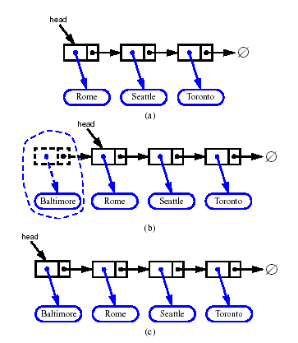
Inserting at the Head (1/2)
Allocate a new node
Insert the new element
Have the new node point to old head
Update head to point to the new node

Slide 11
Inserting at the Head (2/2)
Algorithm addFirst(v)
{
v.setNext(head); // make v point to the old head node
head = v; // make head point to the new node
size =size+1; // increment the node count
}

Slide 12
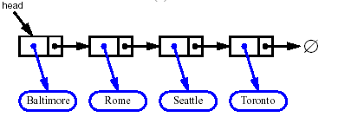


Removing at the Head (1/2)
Update head to point to next node in the list
Allow garbage collector to reclaim the former first node

Slide 13
Removing at the Head (2/2)
Algorithm removeFirst()
{
if ( head = null )
Indicate an error: the list is empty;
t = head ;
/* make head point to the next node (or null) */
head = head.getNext();
t.setNext(null); //null out the next pointer of the removed node
size = size - 1; //decrement the node count
}

Slide 14
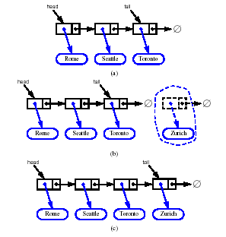
Inserting at the Tail (1/2)
Allocate a new node
Insert the new element
Have the new node point to null
Have the old last node point to new node
Update tail to point to new node

Slide 15
Inserting at the Tail (2/2)
Algorithm addLast(v)
{
v.setNext(null); //make the new node v point to null object
tail.setNext(v); //make the old tail node point to the new node
tail = v ; //make tail point to the new node
size = size +1; //increment the node count
}

Slide 16
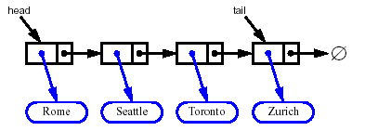
Removing at the Tail (1/2)
Removing the tail node of a singly linked list cannot be done in constant time.
We need to traverse the whole linked list to remove the tail node, which takes O(n) time, where n is the number of nodes in the linked list.

Slide 17
Removing at the Tail (2/2)
Algorithm removeLast()
{
if ( size = 0 )
Indicate an error: the list is empty;
else
{ if ( size = 1 ) // only one node
head = null;
else // at least two nodes
{ t = head; /* make t point to the head */
while ( t.getNext != null ) /* find the last node */
{ s = t;
t = t.getNext(); }
s.setNext(null); //null out the next pointer of the last node
}
size = size - 1; //decrement the node count
}
}

Slide 18
Doubly Linked List
A doubly linked list is a concrete data structure consisting of a sequence of nodes.
Each node stores:
  element
  link to the previous node
  link to the next node
Special trailer and header nodes
prev
next
elem
node
header
nodes/positions
trailer
elements

Slide 19
The Node Class of Doubly Linked List
  /** Node of a doubly linked list of strings */
  public class DNode {
  protected String element; // String element stored by a node
  protected DNode next, prev; // Pointers to next and previous nodes
  /** Constructor that creates a node with given fields */
  public DNode(String e, DNode p, DNode n) {
  element = e;
  prev = p;
  next = n; } /** Returns the element of this node */
  public String getElement() { return element; } /** Returns the previous node of this node */
  public DNode getPrev() { return prev; } /** Returns the next node of this node */
  public DNode getNext() { return next; } /** Sets the element of this node */
  public void setElement(String newElem) { element = newElem; }
  /** Sets the previous node of this node */
  public void setPrev(DNode newPrev) { prev = newPrev; }
  /** Sets the next node of this node */
  public void setNext(DNode newNext) { next = newNext; }
  }

Slide 20
Inserting at the Head (1/2)
header
trailer
Rome
Seattle
New York
(a) Before the insertion
header
trailer
Sydney
Rome
Seattle
New York
(b) After the insertion

Slide 21
Inserting at the Head (2/2)
Algorithm addFirst(v)
{
w = header.getNext(); // make w point to the first node
v.setNext(w); // make v point to the old first node
v.setPrev(header); // make v point to the header
w.setPrev(v); // make the old first node point to v
header.setNext(v); // make header point to v
size = size+1; // increment the node count
}

Slide 22
Inserting in the Middle (1/2)
header
trailer
Rome
Seattle
New York
(a) Before the insertion
header
trailer
Rome
Seattle
Sydney
New York
(b) After the insertion

Slide 23
Inserting in the Middle (2/2)
Algorithm addAfter(v,z)
{
w=v.getNext(); // make w point to the node after v
z.setPrev(v); // link z to its predecessor, v
z.setNext(w); // link z to its successor, w
w.setPrev(z); // link w to its new predecessor, z
v.setNext(z); // link v to its new successor, z
size = size+1; // increment the node count
}

Slide 24
Removing at the Tail (1/2)
header
trailer
Rome
Seattle
Sydney
New York
(a) Before the deletion
header
trailer
Rome
Seattle
Sydney
(b) After the deletion

Slide 25
Removing at the Tail (2/2)
Algorithm removeLast():
{
if ( size = 0 )
Indicate an error: this list is empty;
v = trailer.getPrev() // make v point to the last node
u = v.getPrev(); // u points to the node before the last node
trailer.setPrev(u);
u.setNext(trailer);
v.setPrev(null);
v.setNext(null);
size = size -1;
}

Slide 26
Removing in the Middle (1/2)
header
trailer
Rome
Seattle
Sydney
New York
(a) Before the deletion
header
trailer
Rome
Seattle
New York
(b) After the deletion

Slide 27
Removing in the Middle (2/2)
Algorithm remove(v):
{
u = v.getPrev() // make u point to the node before v
w = v.getNext(); // w points to the node after v
w.setPrev(u); // link out v
u.setNext(w);
v.setPrev(null); // null out the pointers of v
v.setNext(null);
size = size -1; // decrement the node count
}

Slide 28

Programming with Recursion

Slide 29
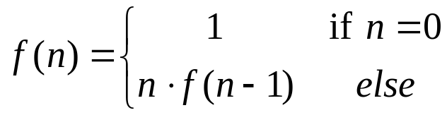
The Recursion Pattern
Recursion: when a method calls itself
Classic example--the factorial function:
  n! = 1· 2· 3· ··· · (n-1)· n
Recursive definition:
As a Java method:
  // recursive factorial function
  public static int recursiveFactorial(int n) {
  if (n == 0) return 1; // basis case
  else return n * recursiveFactorial(n- 1); // recursive case
  }

Slide 30
Content of a Recursive Method
Base case(s)
  Values of the input variables for which we perform no recursive calls are called base cases (there should be at least one base case).
  Every possible chain of recursive calls must eventually reach a base case.
Recursive calls
  Calls to the current method.
  Each recursive call should be defined so that it makes progress towards a base case.

Slide 31
Visualizing Recursion
Example recursion trace:
Recursion trace
A box for each recursive call
An arrow from each caller to callee
An arrow from each callee to caller showing return value
call
return
4
*
6
=
24
final answer
recursiveFactorial
(
4
)
call
return
3
*
2
=
6
recursiveFactorial
(
3
)
call
return
2
*
1
=
2
recursiveFactorial
(
2
)
call
return
1
*
1
=
1
recursiveFactorial
(
1
)
call
return
1
recursiveFactorial
(
0
)

Slide 32
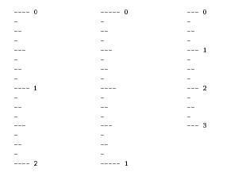
Example – English Rulers
Define a recursive way to print the ticks and numbers like an English ruler:

Slide 33
A Recursive Method for Drawing Ticks on an English Ruler
// draw a tick with no label
public static void drawOneTick(int tickLength) { drawOneTick(tickLength, - 1); }
// draw one tick
public static void drawOneTick(int tickLength, int tickLabel) {
for (int i = 0; i < tickLength; i++)
System.out.print("-");
if (tickLabel >= 0) System.out.print(" " + tickLabel);
System.out.print("\n");
}
public static void drawTicks(int tickLength) { // draw ticks of given length
if (tickLength > 0) { // stop when length drops to 0
drawTicks(tickLength- 1); // recursively draw left ticks
drawOneTick(tickLength); // draw center tick
drawTicks(tickLength- 1); // recursively draw right ticks
}
}
public static void drawRuler(int nInches, int majorLength) { // draw ruler
drawOneTick(majorLength, 0); // draw tick 0 and its label
for (int i = 1; i <= nInches; i++) {
drawTicks(majorLength- 1); // draw ticks for this inch
drawOneTick(majorLength, i); // draw tick i and its label
}
}

Slide 34
Visualizing the DrawTicks Method
An interval with a central tick length L >1 is composed of the following:
  an interval with a central tick length L-1,
  a single tick of length L,
  an interval with a central tick length L-1.
drawTicks
(
3
)
Output
drawTicks
(
2
)
drawTicks
(
1
)
drawTicks
(
0
)
drawOneTick
(
1
)
drawTicks
(
0
)
drawOneTick
(
2
)
drawTicks
(
1
)
drawTicks
(
0
)
drawOneTick
(
1
)
drawTicks
(
0
)
drawOneTick
(
3
)
drawTicks
(
2
)
(
previous pattern repeats
)

Slide 35

Using Recursion

Slide 36
Recall the Recursion Pattern
Recursion: when a method calls itself
Classic example--the factorial function:
  n! = 1· 2· 3· ··· · (n-1)· n
Recursive definition:
As a Java method:
  // recursive factorial function
  public static int recursiveFactorial(int n) {
  if (n == 0) return 1; // basis case
  else return n * recursiveFactorial(n- 1); // recursive case
  }

Slide 37
Linear Recursion
Test for base cases.
  Begin by testing for a set of base cases (there should be at least one).
  Every possible chain of recursive calls must eventually reach a base case, and the handling of each base case should not use recursion.
Recur once.
  Perform a single recursive call. (This recursive step may involve a test that decides which of several possible recursive calls to make, but it should ultimately choose to make just one of these calls each time we perform this step.)
  Define each possible recursive call so that it makes progress towards a base case.

Slide 38
A Simple Example of Linear Recursion
Example recursion trace:
Algorithm LinearSum(A, n)
{
Input :
A integer array A and an integer
n such that A has at least n
elements
Output :
The sum of the first n integers in A
if ( n = 1) return A[0];
else
return LinearSum(A, n - 1) + A[n - 1];
}
call
return
15
+
A
[
4
] =
15
+
5
=
20
LinearSum
(
A
,
5
)
call
return
13
+
A
[
3
] =
13
+
2
=
15
LinearSum
(
A
,
4
)
call
return
7
+
A
[
2
] =
7
+
6
=
13
LinearSum
(
A
,
3
)
call
return
4
+
A
[
1
] =
4
+
3
=
7
LinearSum
(
A
,
2
)
call
return
A
[
0
] =
4
LinearSum
(
A
,
1
)

Slide 39
Reversing an Array
Algorithm ReverseArray(A, i, j)
{
Input : An array A and nonnegative integer indices i and j
Output : The reversal of the elements in A starting at index i and ending at j
if (i < j )
{
swap A[i] and A[j];
ReverseArray(A, i + 1, j - 1);
}
}

Slide 40
Defining Arguments for Recursion
In creating recursive methods, it is important to define the methods in ways that facilitate recursion.
This sometimes requires we define additional parameters that are passed to the method.
For example, we defined the array reversal method as ReverseArray(A, i, j), not ReverseArray(A).

Slide 41
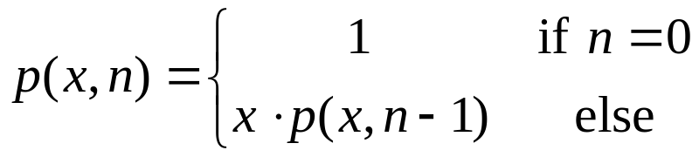
Computing Powers
The power function, p(x,n)=x^{n}, can be defined recursively:
This leads to an power function that runs in O(n) time (for we make n recursive calls).
We can do better than this, however.

Slide 42
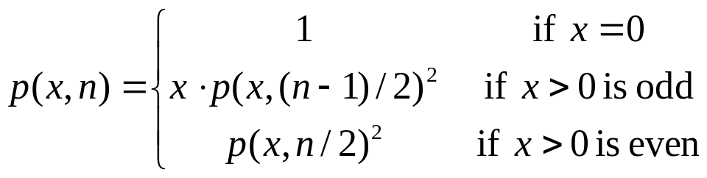
Recursive Squaring
We can derive a more efficient linearly recursive algorithm by using repeated squaring:
For example,
  2⁴ = 2^{(4/2)2} = (2^{4/2})² = (2²)² = 4² = 16
  2⁵ = 2^{1+(4/2)2} = 2(2^{4/2})² = 2(2²)² = 2(4²) = 32
  2⁶ = 2^{(6/ 2)2} = (2^{6/2})² = (2³)² = 8² = 64
  2⁷ = 2^{1+(6/2)2} = 2(2^{6/2})² = 2(2³)² = 2(8²) = 128.

Slide 43
A Recursive Squaring Method
Algorithm Power(x, n)
{
Input : A number x and integer n = 0
Output : The value x^{n}
if (n = 0) return 1;
if (n is odd )
{ y = Power(x, (n - 1)/ 2);
return x*y*y; }
else
{ y = Power(x, n/ 2);
return y*y; }
}

Slide 44
Analyzing the Recursive Squaring Method
Algorithm Power(x, n)
{
Input : A number x and integer n = 0
Output : The value x^{n}
if (n = 0) return 1;
if (n is odd )
{ y = Power(x, (n - 1)/ 2);
return x*y*y; }
else
{ y = Power(x, n/ 2);
return y*y; }
}
Each time we make a recursive call we halve the value of n; hence, we make log n recursive calls. That is, this method runs in O(log n) time.
It is important that we used a variable twice here rather than calling the method twice.

Slide 45
Tail Recursion
Tail recursion occurs when a linearly recursive method makes its recursive call as its last step.
The array reversal method is an example.
Such methods can be easily converted to non-recursive methods (which saves on some resources).
Example:
  Algorithm IterativeReverseArray(A, i, j )
  { Input : An array A and nonnegative integer indices i and j
  Output : The reversal of the elements in A starting at index i and ending at j
  while ( i < j )
    { swap A[i] and A[j];
    i = i + 1;
    j = j – 1;
  }
  }

Slide 46
Binary Recursion
Binary recursion occurs whenever there are two recursive calls for each non-base case.
Example: the DrawTicks method for drawing ticks on an English ruler.

Slide 47
A Binary Recursive Method for Drawing Ticks
// draw a tick with no label
public static void drawOneTick(int tickLength) { drawOneTick(tickLength, - 1); }
// draw one tick
public static void drawOneTick(int tickLength, int tickLabel) {
for (int i = 0; i < tickLength; i++)
System.out.print("-");
if (tickLabel >= 0) System.out.print(" " + tickLabel);
System.out.print("\n");
}
public static void drawTicks(int tickLength) { // draw ticks of given length
if (tickLength > 0) { // stop when length drops to 0
drawTicks(tickLength- 1); // recursively draw left ticks
drawOneTick(tickLength); // draw center tick
drawTicks(tickLength- 1); // recursively draw right ticks
}
}
public static void drawRuler(int nInches, int majorLength) { // draw ruler
drawOneTick(majorLength, 0); // draw tick 0 and its label
for (int i = 1; i <= nInches; i++) {
drawTicks(majorLength- 1); // draw ticks for this inch
drawOneTick(majorLength, i); // draw tick i and its label
}
}
Note the two recursive calls

Slide 48
Another Binary Recursive Method
Problem: add all the numbers in an integer array A:
  Algorithm BinarySum(A, i, n)
  { Input : An array A and integers i and n
  Output : The sum of the n integers in A starting at index i
  if (n = 1) return A[i];
  return BinarySum(A, i, n/ 2) + BinarySum(A, i + n/ 2, n/ 2);
  }
Example trace:
0
,
8
0
,
4
4
,
4
0
,
2
2
,
2
4
,
2
6
,
2
0
,
1
1
,
1
2
,
1
3
,
1
4
,
1
5
,
1
6
,
1
7
,
1

Slide 49
Computing Fibanacci Numbers
Fibonacci numbers are defined recursively:
    F₀ = 0
    F₁ = 1
    F_{i} = F_{i-1} ⁺ F_{i-2} for i > 1.
As a recursive algorithm (first attempt):
      Algorithm BinaryFib(k)
      { Input : Nonnegative integer k
      Output : The kth Fibonacci number F_{k}
      if ( k =0 or 1) return k;
      else
      return BinaryFib(k - 1) + BinaryFib(k - 2);
      }

Slide 50
Analyzing the Binary Recursion Fibonacci Algorithm
Let n_{k} denote number of recursive calls made by BinaryFib(k). Then
  n₀ = 1
  n₁ = 1
  n₂ = n₁ + n₀ + 1 = 1 + 1 + 1 = 3
  n₃ = n₂ + n₁ + 1 = 3 + 1 + 1 = 5
  n₄ = n₃ + n₂ + 1 = 5 + 3 + 1 = 9
  n₅ = n₄ + n₃ + 1 = 9 + 5 + 1 = 15
  n₆ = n₅ + n₄ + 1 = 15 + 9 + 1 = 25
  n₇ = n₆ + n₅ + 1 = 25 + 15 + 1 = 41
  n₈ = n₇ + n₆ + 1 = 41 + 25 + 1 = 67.
Note that the value at least doubles for every other value of n_{k}. That is, n_{k} > 2^{k/2}. It is exponential!

Slide 51
A Better Fibonacci Algorithm
Use linear recursion instead:
    Algorithm LinearFibonacci(k):
    { Input : A nonnegative integer k
    Output : Pair of Fibonacci numbers (F_{k}, F_{k-1})
    if ( k = 1) return (k, 0);
    else
    {
    (i, j) = LinearFibonacci(k - 1);
    return (i +j, i);
    }
    }
Runs in O(k) time.

Slide 52
Multiple Recursion
Motivating example: summation puzzles
    pot + pan = bib
    dog + cat = pig
    boy + girl = baby
Multiple recursion: makes potentially many recursive calls (not just one or two).

Slide 53
Algorithm for Multiple Recursion
Algorithm PuzzleSolve(k,S,U)
{
Input: An integer k, sequence S, and set U (the universe of elements to test)
Output: An enumeration of all k-length extensions to S using elements in U
without repetitions
for all e in U do
{ Remove e from U; // e is now being used
Add e to the end of S;
if (k = 1)
{
Test whether S is a configuration that solves the puzzle;
if ( S solves the puzzle ) return “Solution found: ” S;
}
else
PuzzleSolve(k - 1, S,U);
Add e back to U; // e is now unused
Remove e from the end of S;
}
}

Slide 54
Visualizing PuzzleSolve
Initial call
PuzzleSolve
(
3
,
()
,{
a
,
b
,
c
}
)
PuzzleSolve
(
2
,
a
,{
b
,
c
}
)
PuzzleSolve
(
2
,
b
,{
a
,
c
}
)
PuzzleSolve
(
2
,
c
,{
a
,
b
}
)
PuzzleSolve
(
1
,
ab
,{
c
}
)
PuzzleSolve
(
1
,
ba
,{
c
}
)
PuzzleSolve
(
1
,
ca
,{
b
}
)
abc
bac
cab
PuzzleSolve
(
1
,
ac
,{
b
}
)
PuzzleSolve
(
1
,
bc
,{
a
}
)
PuzzleSolve
(
1
,
cb
,{
a
}
)
acb
bca
cba

Slide 55
References
Chapter 3, Data Structures and Algorithms by Goodrich and Tamassia.
Garbage Collection by Bill Venners (http://www.artima.com/insidejvm/ed2/gc.html).

